Slide 1
MSE 320: Trike Project - Part 1
Md
Karamvir Sepehr Rezvani - 301291960
Harsimranjeet

Slide 2
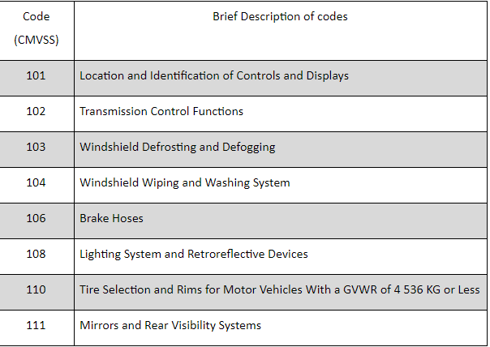
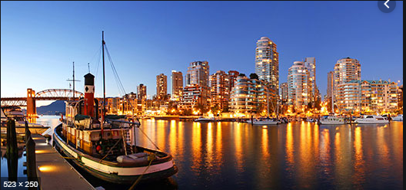
User Requirements
City: Vancouver
Price range : $ 15,000- $25,000
Maximum speed : 60 km/h
Codes and Standards:

Slide 3
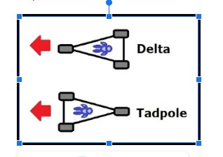
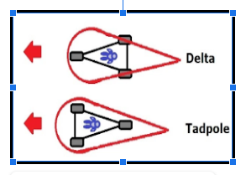
DELTA VS TADPOLE

Slide 4

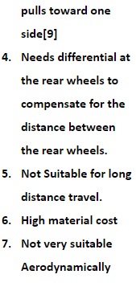
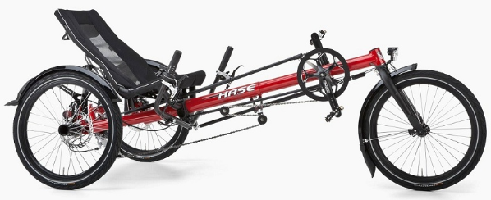
Delta configuration with space frame

Slide 5

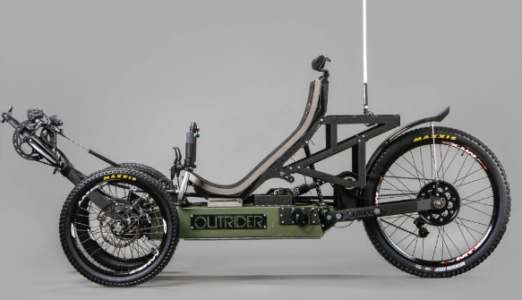
Tadpole with monocoque frame

Slide 6
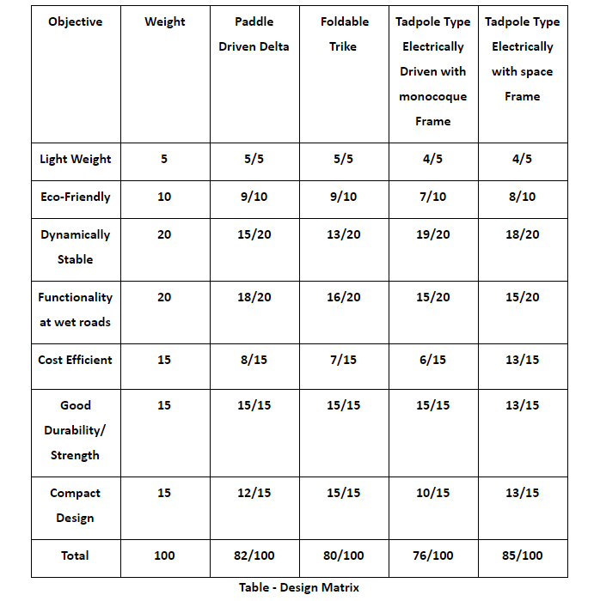
Decision Matrix

Slide 7
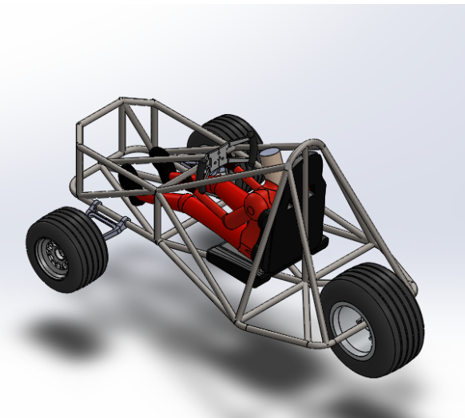
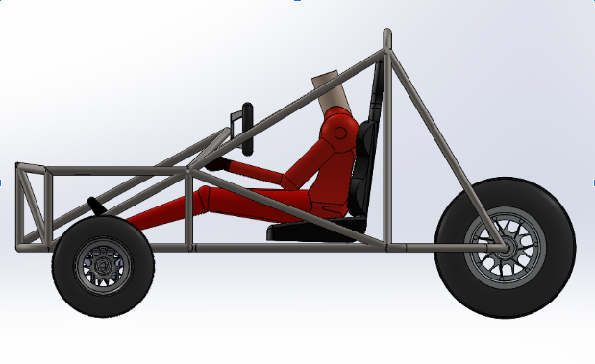
Final Design

Slide 8
